Slide 1

Source-Free Object Detection by
Learning to Overlook Domain Style
Shuaifeng Li¹ Mao Ye¹ Xiatian Zhu² Lihua Zhou¹ Lin Xiong¹
¹University of Electronic Science and Technology of China
²University of Surrey

Slide 2
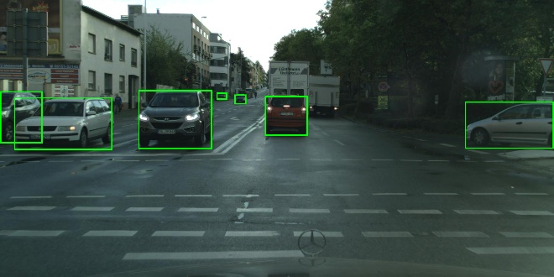
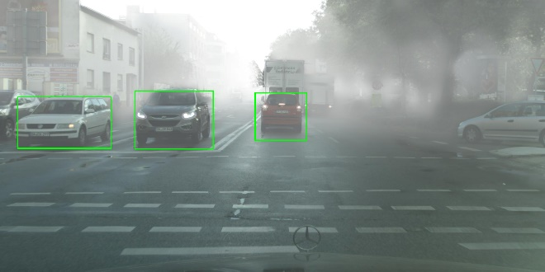
CHALLENGE
Source-Free Object Detection
PROBLEM
Domain shift
Performance
decay
Train set
Test set
Source domain
Target domain
Transfer knowledge from source domain to target domain
by mitigating domain shift

Slide 3






PROBLEM
CHALLENGE
Source-Free Object Detection
Source data
with labels
Source data
with labels
train
train
Unavailable
How to fine-tune
Available
Target data
without labels
Source detector
Target detector

Slide 4
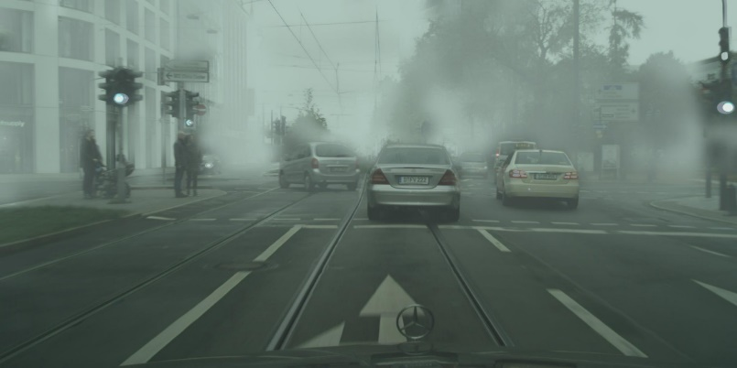
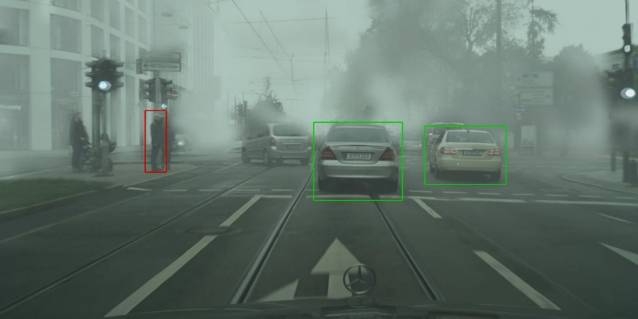
Traditional pseudo label strategy
Target domain image
Detector
Pseudo labels
IDEA
Self-supervised learning

Slide 5
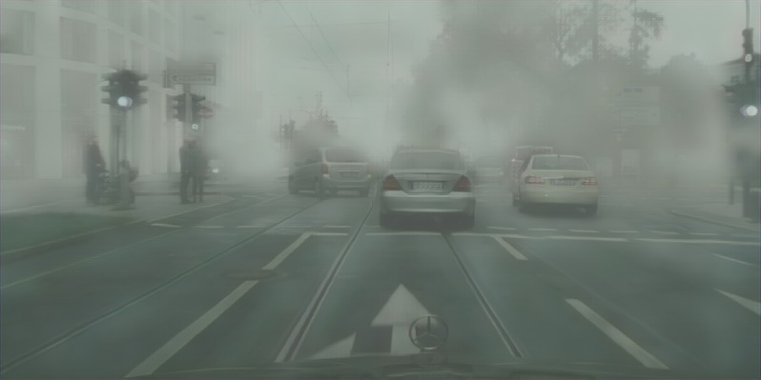
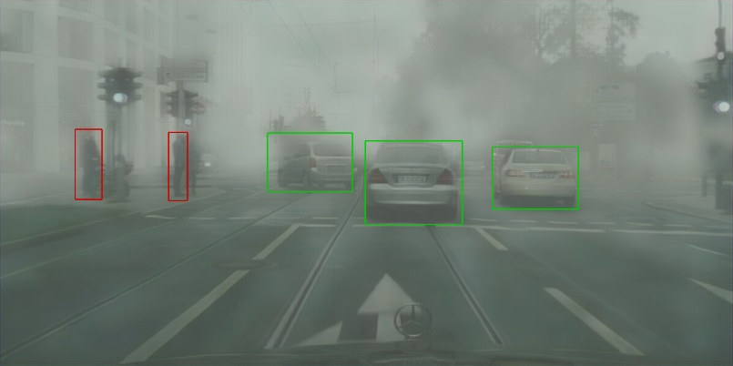
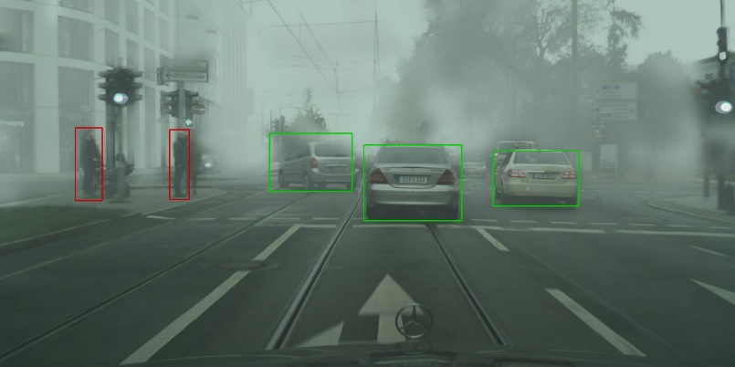
IDEA
Overlook domain style strategy
Style enhanced image
Detector(Student)
Detection results
Two-way
knowledge
distillation
Enhancement
Overlooking
style
Target domain image
Detector(Teacher)
Detection results

Slide 6
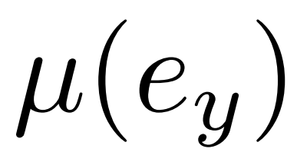
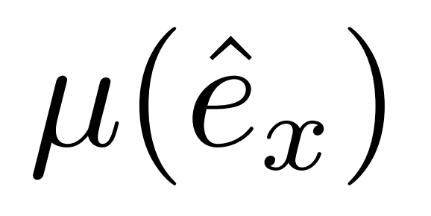
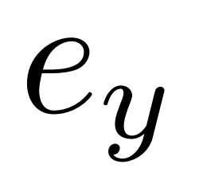
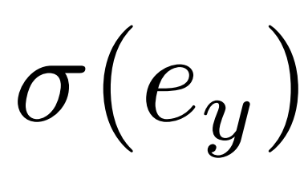

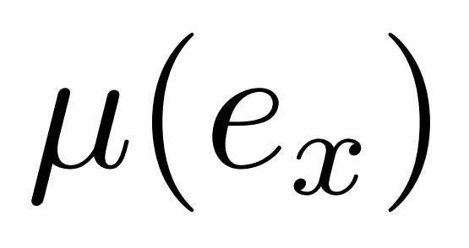
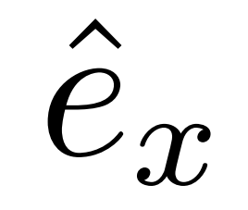

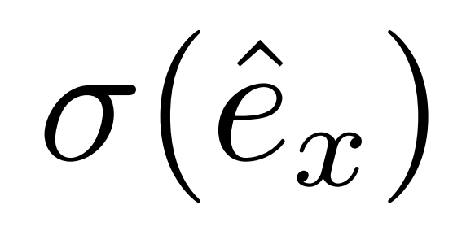
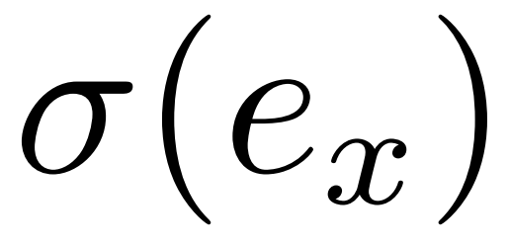
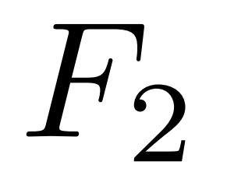
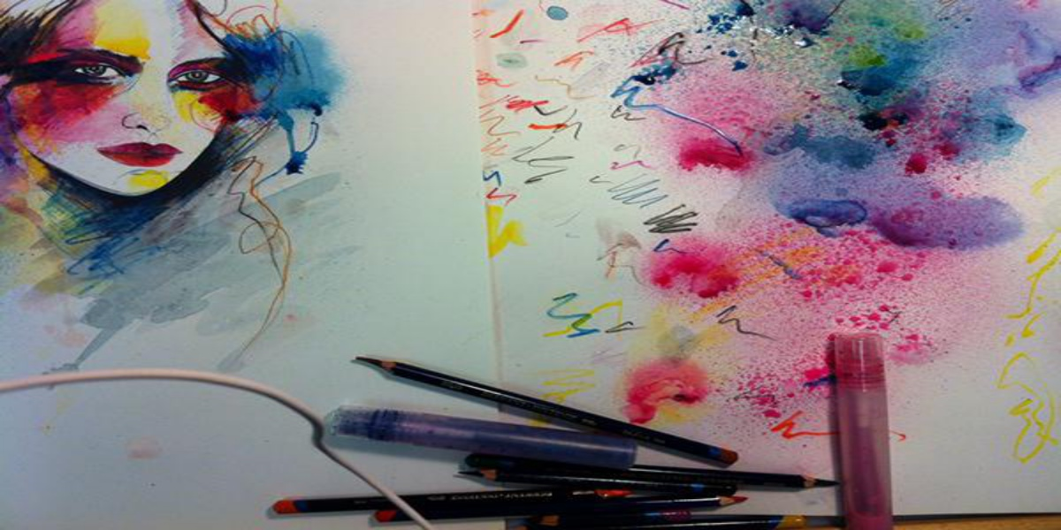



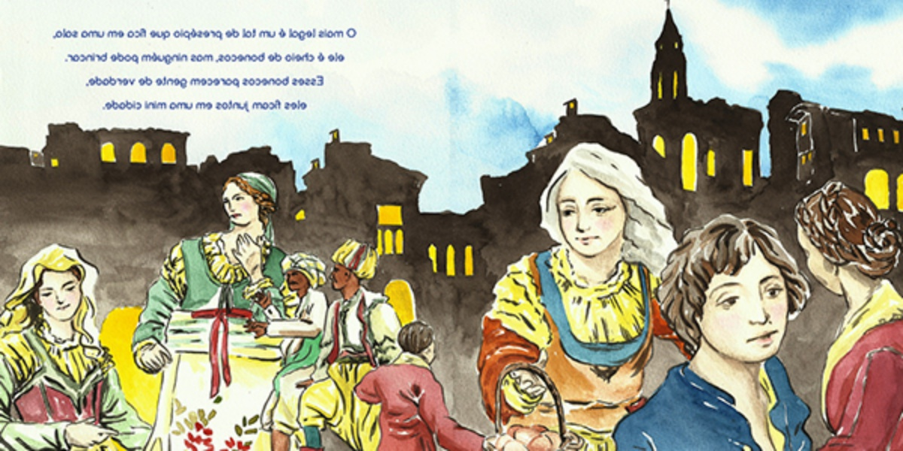


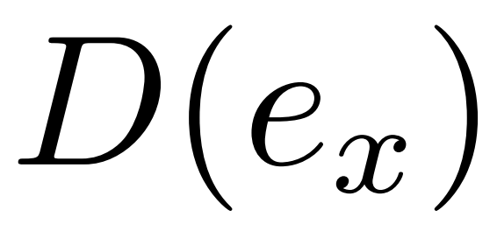

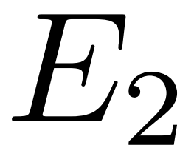

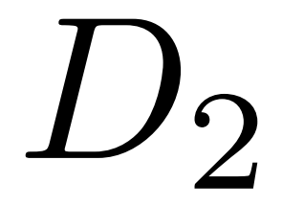
Style Enhancement module
Overlooking style module
Fixed
Trainable
DETAIL
Replace
Replace
Style image
(a random target image)
Style enhanced image
Target image
Reconstructed target image

Slide 7
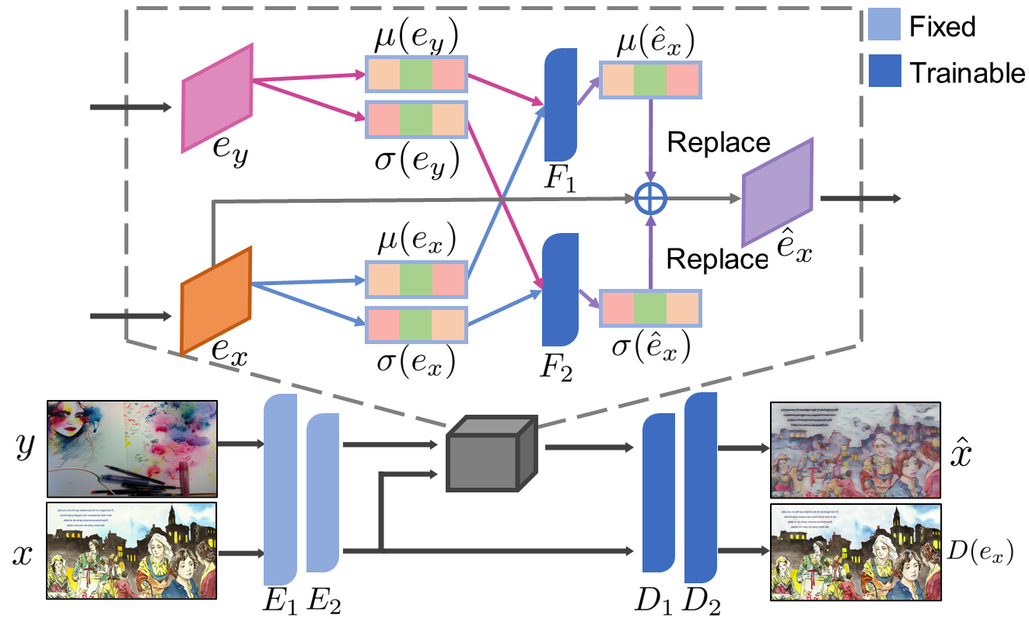
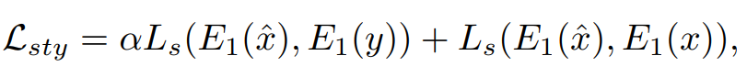
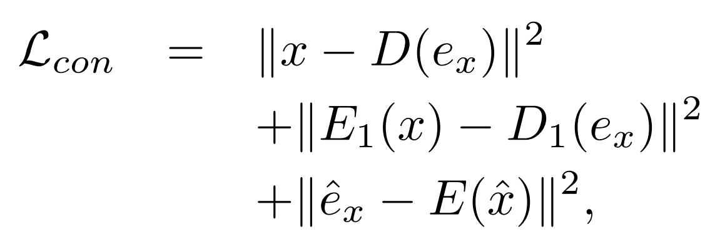
DETAIL
Style Enhancement module
Overlooking style module
Style consistency
Content consistency

Slide 8
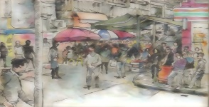


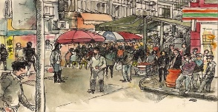
DETAIL
Style Enhancement module
Overlooking style module
Student
Style enhanced image
Style enhanced feature
RCNN
Features
Predictions
Graph based image-level alignment
Shared RPN
Graph based class-wise instance-level alignment
Features
Predictions
Target image
Target feature
RCNN
Teacher

Slide 9
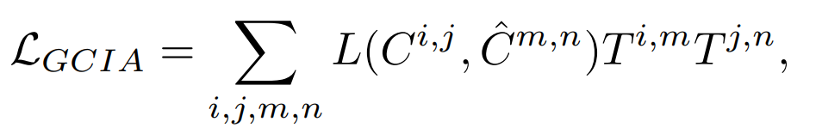
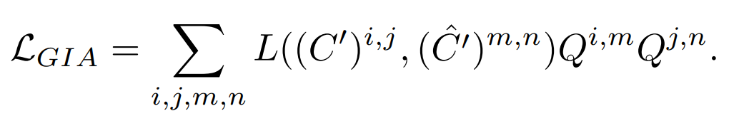
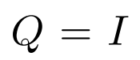
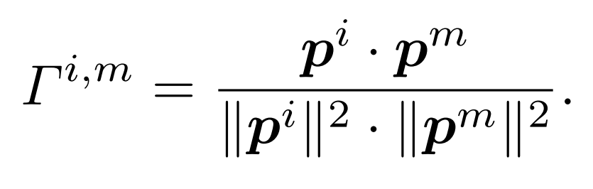
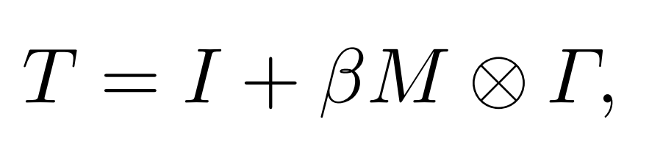
DETAIL
Style Enhancement module
Overlooking style module
Student
Graph based class-wise instance-level alignment
Graph based image-level alignment
Features
Predictions
Graph based image-level alignment
Class-wise graph matching matrix T
Graph based class-wise instance-level alignment
Features
Predictions
Teacher

Slide 10
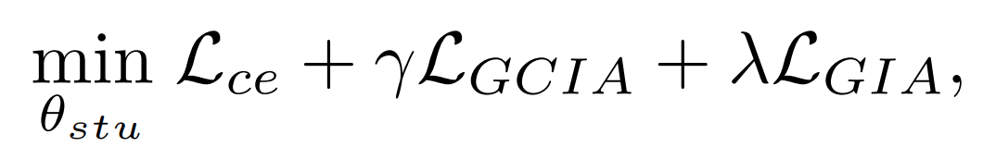
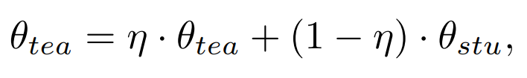
DETAIL
Two-way knowledge distillation
Style enhanced image
Student
Able to
overlook style
Parameter updating of the student
Parameter updating of the teacher
Alignment
direction
Knowledge flow
direction
Knowledge flow
direction
Teacher
Able to
overlook style
Target image

Slide 11
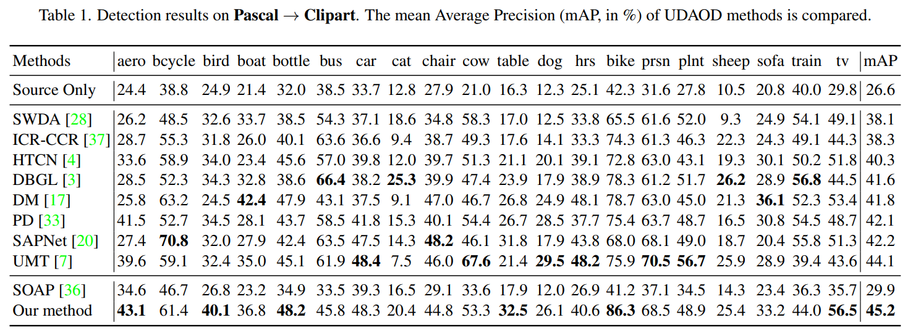
EXPERIMENT
Gain the performance by +15.3%

Slide 12
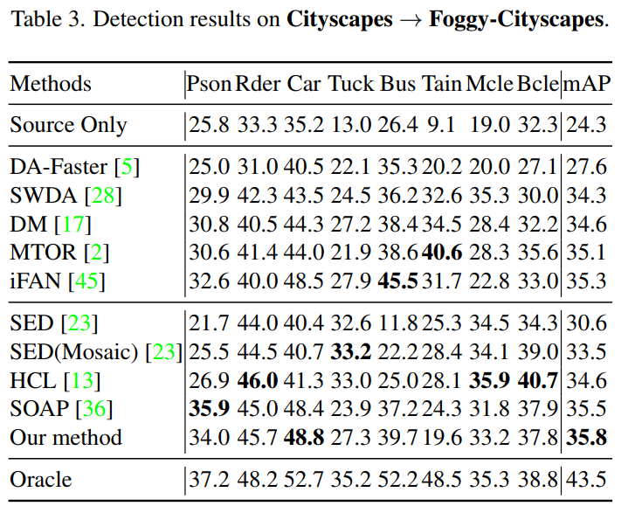
EXPERIMENT
Achieve the state-of-the-art
performance

Slide 13
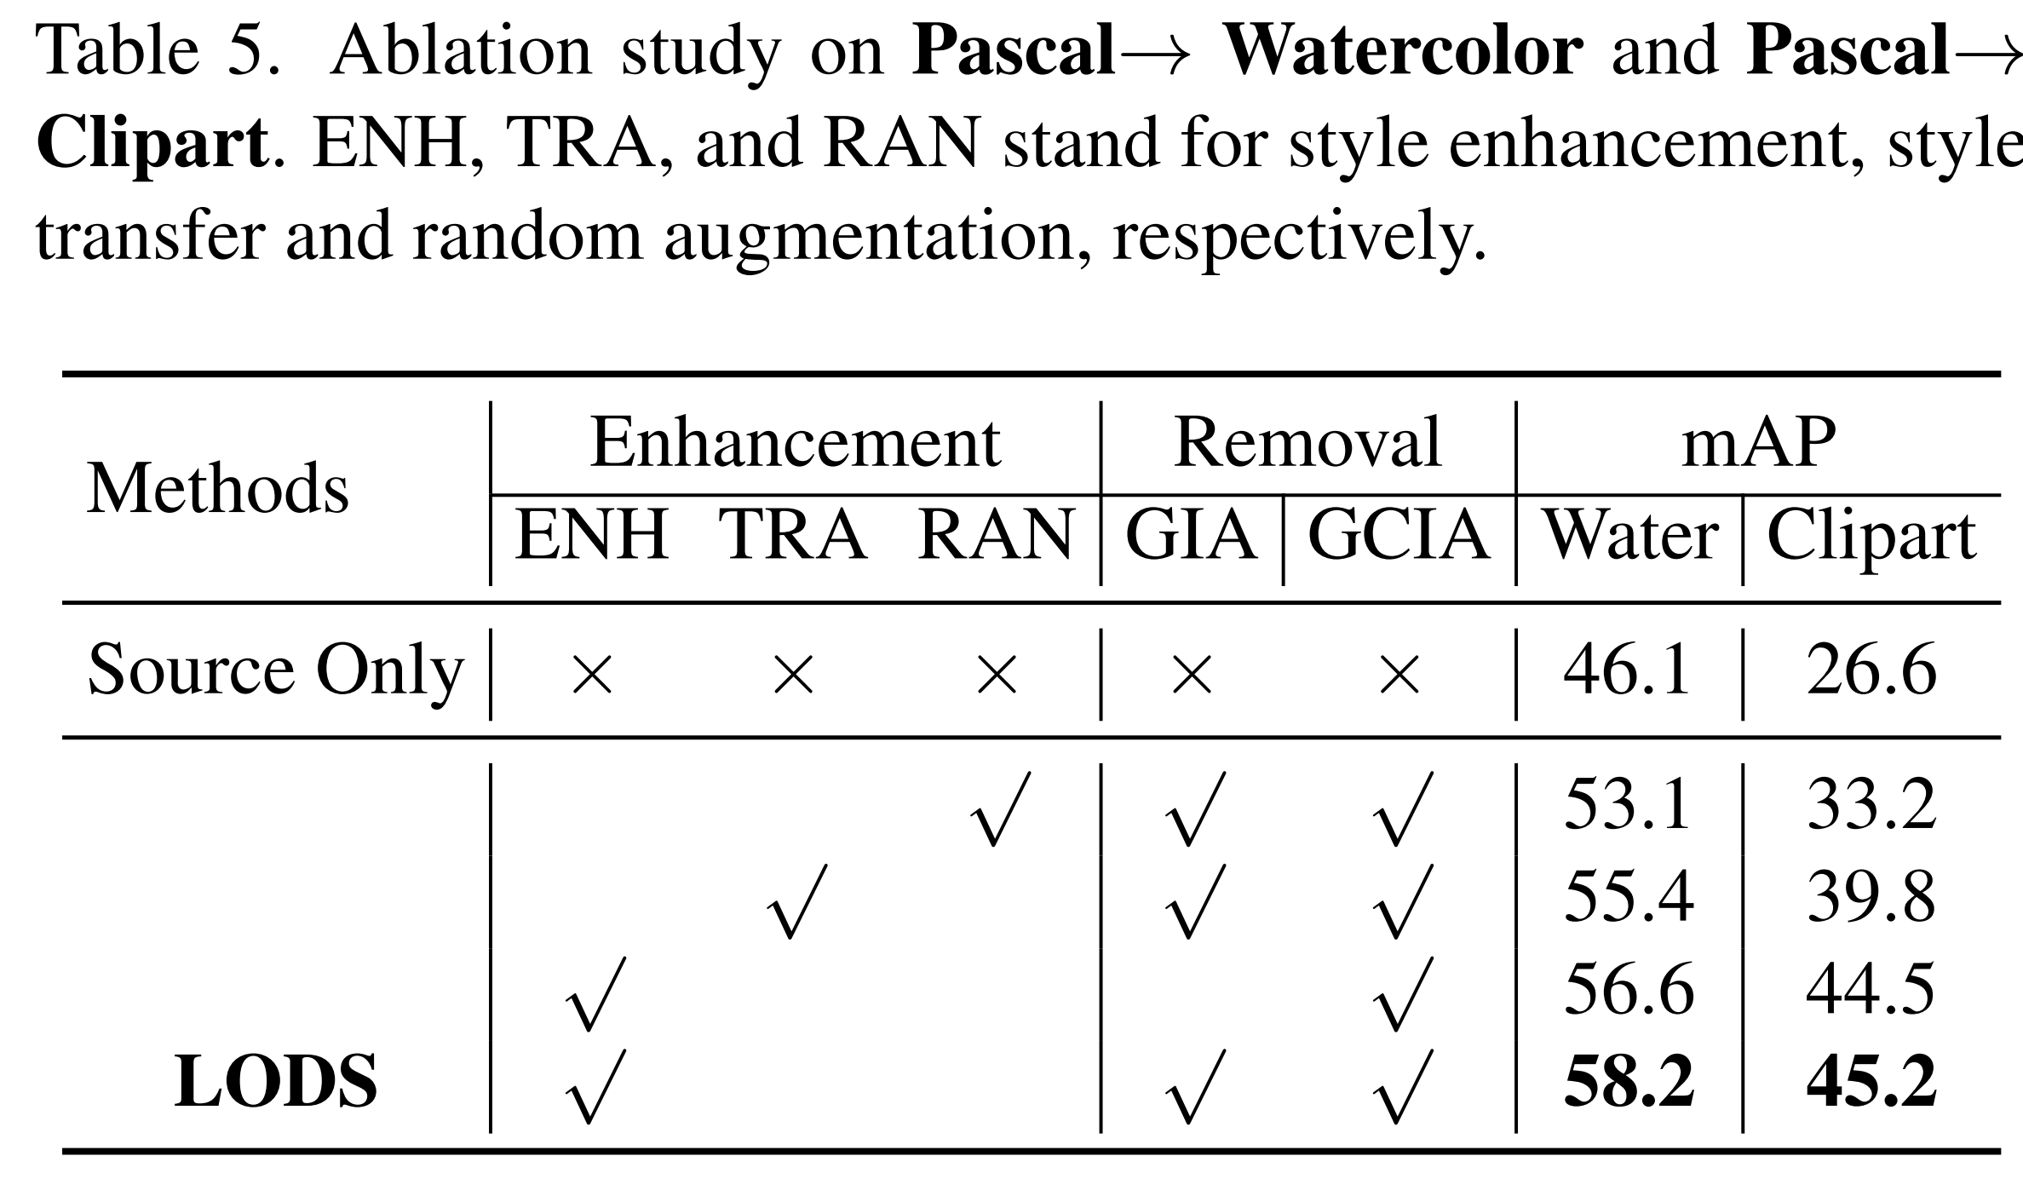
EXPERIMENT
Effectiveness of Enhancement
Effectiveness of Overlooking

Slide 14
EXPERIMENT
Effectiveness of Enhancement
Effectiveness of Overlooking

Slide 15
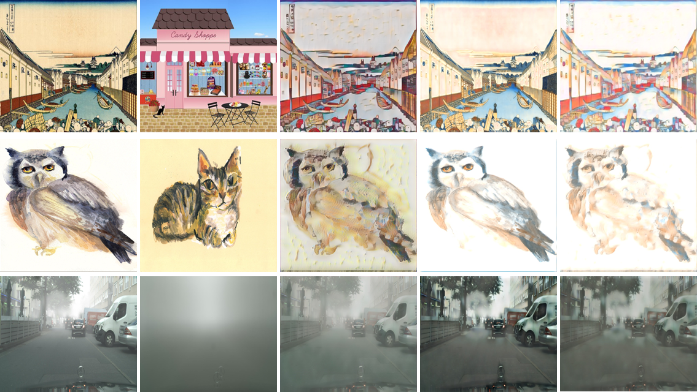
EXPERIMENT
Validation of the learned ability to overlook target domain style.
Pascal to
Clipart
Pascal to
Watercolor
Cityscapes to
Foggy-Cityscapes
Target image
Style image
SE image
RT image
RSE image
SE: Style enhancement
RT: the reconstructed image with target feature
RSE: the reconstructed image with style enhanced feature
Target image VS RT image
SE image VS RSE image

Slide 16
To learn more about this paper,
welcome to our poster session 2.2 9b

